Slide 1
Transient dynamical events. The FEB hypothesis β Pictoris and Vega
Hervé Beust
Institut de Planétologie et d’Astrophysique de Grenoble
FOST team

Slide 2
Transient dynamical events. The FEB hypothesis β Pictoris and Vega
Falling Evaporationg Bodies (FEBs) in the β Pictoris disk
Vega

Slide 3
I – Falling Evaporationg Bodies (FEBs) in the β Pictoris disk

Slide 4
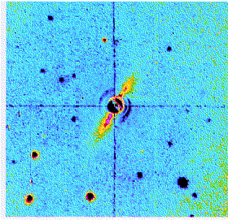
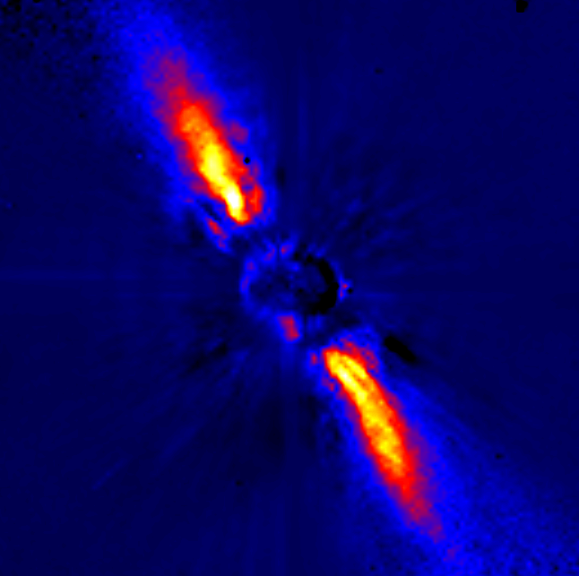
The β Pictoris disk
It is a wide debris disks viewed edge-on
The star is and A5 type star aged ~12 Myrs
Smith & Terrile 1984
Mouillet et al. 1997

Slide 5
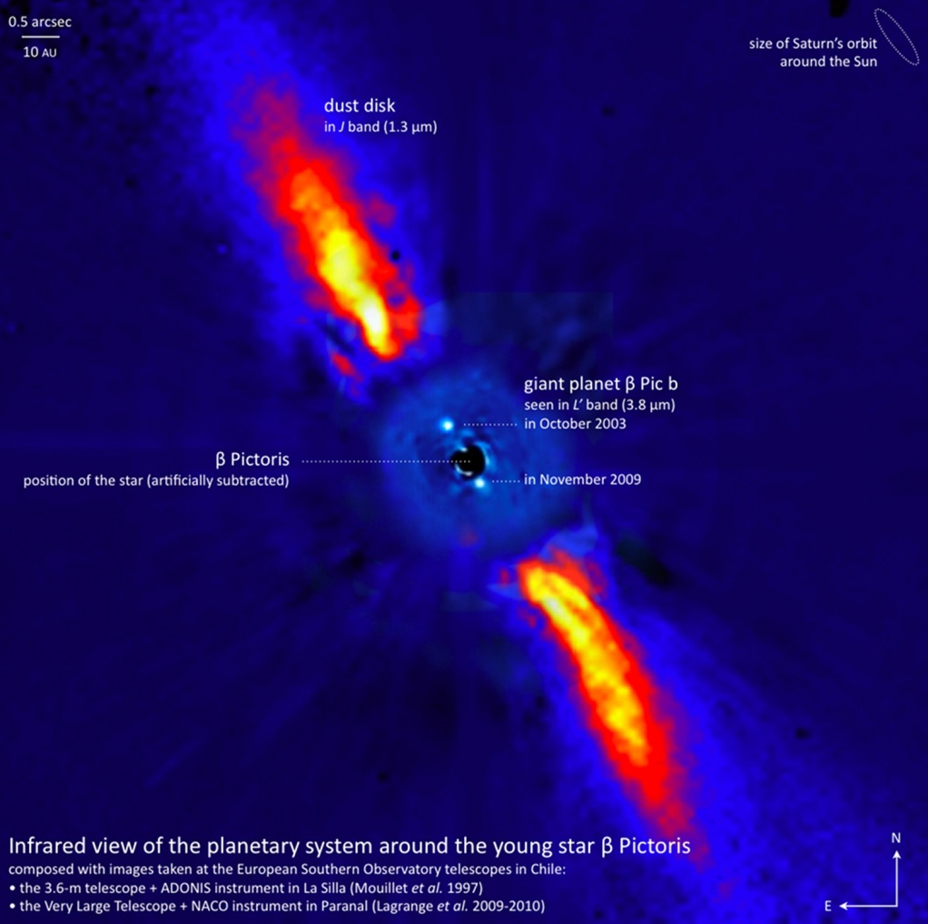
Characteristics of the disk
Mass of the dust : a few lunar
masses at most.
Need for larger hidden bodies
as a source for the dust :
km-sized planetesimals
The disk is distorded by many
ways (asymmetries, warps,
etc…) : need for planetary
perturbations ( planets ?)
A giant planet (~8 M_{J})was
recently imaged@ 8-10 AU
(Lagrange et al. 2008, 2009) …

Slide 6
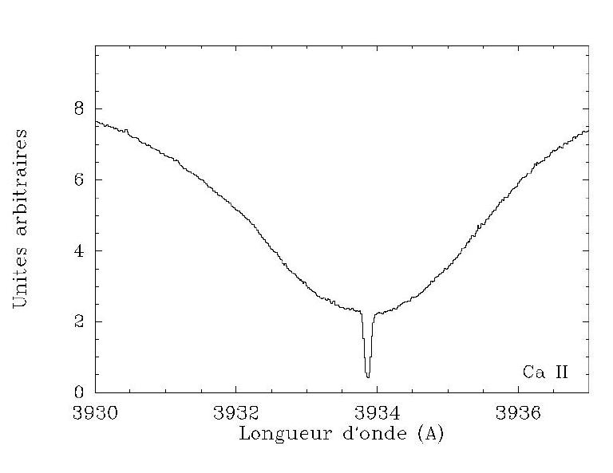
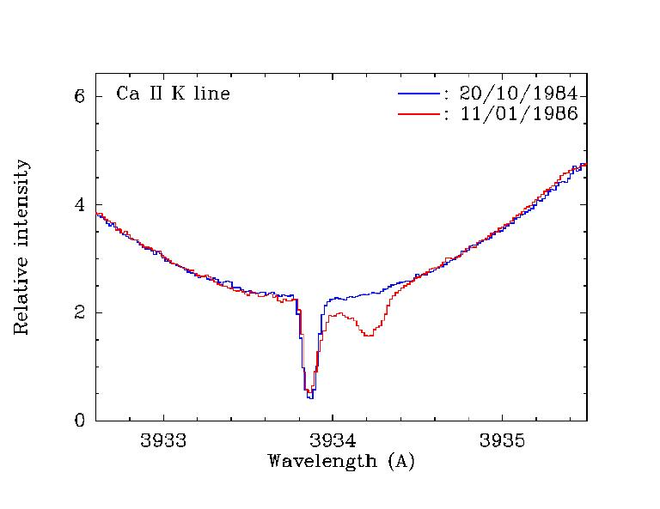
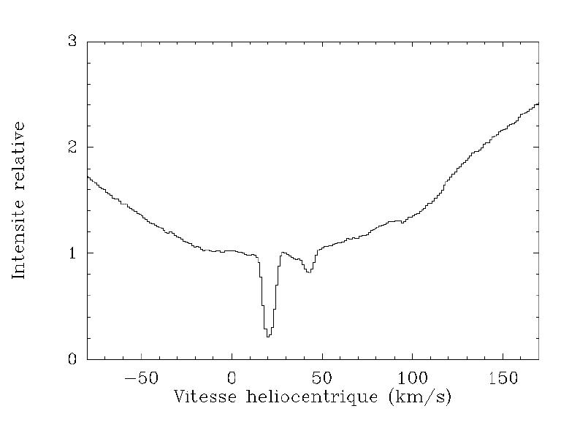
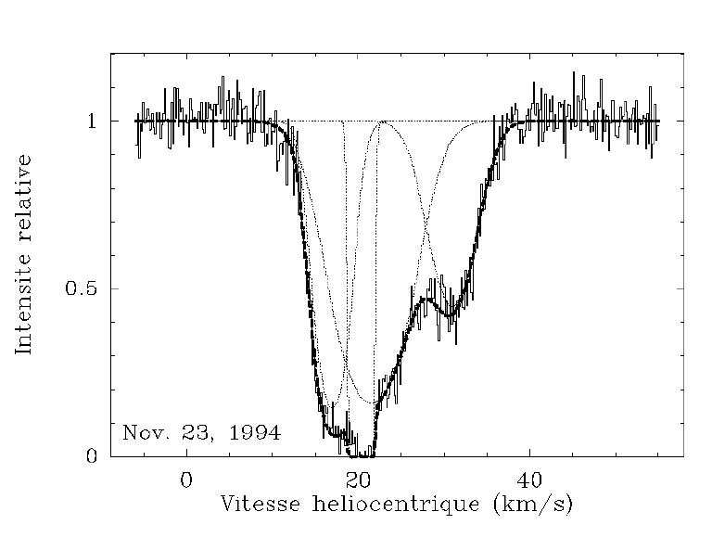
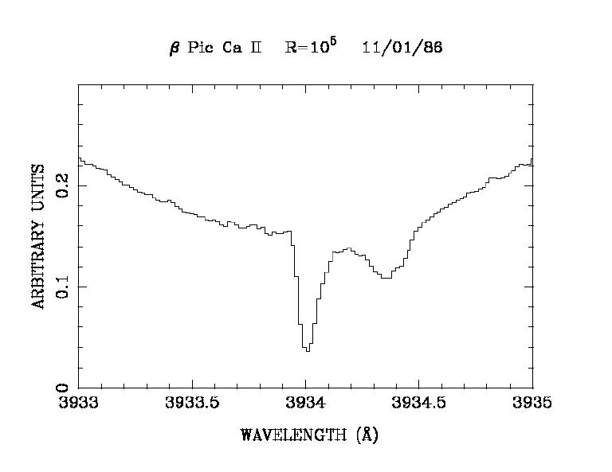
Gas in the β Pictoris disk
Circumstellar gas is detected in absorption in the spectrum of the star (thanks to edge-on orientation)
Apart from a stable component, transient additional, Doppler-shifted components are frequently observed.
They vary on a very short time scale (days – hours)

Slide 7
Characteristics of the transient events
Detected in many spectral lines, but not all ( Ca II, Mg II, Al III…) : only moderately ionized species
Most of the time reshifted (tens to hundreds of km/s), but some blueshifted features
The higher the velocity, the shorter the variation time-scale
Comparison between features in doublet lines  saturated components that do not reach the zero level  The absorbing clouds do not mask the whole stellar surface
~Regularly observed for 20 years : they are frequent but their bulk frequency is erratic
The components observed seem to be correlated (in Ca II) over a time-scale of 2-3 weeks (Beust & Tobin 2004)

Slide 8
The FEBs
(Falling Evaporating Bodies ) scenario
(Beust et al. 1990, 1995, 1998…)
Each of these events is generated by an evaporating body (comet, planetesimal) that crosses the line of sight.
These objets are star-grazing planetesimals (<0.5 AU).
At this short distance the dust sublimates  metallic ions in the coma.
This model naturally explains :
  The infall velocities : projection of the velocity onto the line of sight  close to the star
  The time variability : time to cross the line of sight
  The limited size of the clouds = size of the coma
  The chemical issue : not all species are concerned
  The mere presence of the ions : Most of these species undergo a radiation pressure from the star that overcomes stellar gravity

Slide 9
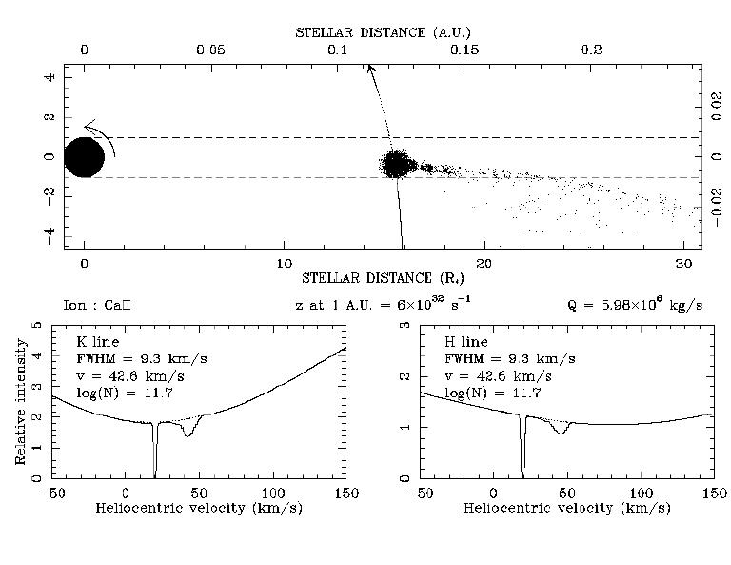
Simulating the FEBs scenario
We compute the dynamics of
metallic ions in the FEBs coma
and the resulting absortion
components.
The ions are subject to the
radiation pressure and to a
drift force by the other species
The different kinds of variable
features (high velocity, low
velocity…) are well reproduced
if we let the periastron distance
vary.
The longitude of periastrons are
not randomly distributed
(predominance of redshifted features)
(Large) cometary production rates are needed (a few 10⁷ kg/s)
Several hundreds of FEBs per year
Question : why so many star-grazers ? What is their dynamical origin ?

Slide 10
FEB dynamics : How do you generate star-grazers ?
A requirement : planetary perturbations  need for planets !
Direct scattering of planetesimals : possible (cf. Vega sims. by Vandeportal et al.) but weakly efficient.
Kozai resonance on initially inclined orbits : efficient but no preferred orientation (rotational invariance)
Mean-motion resonances with a Jovian planet : preferred model

Slide 11
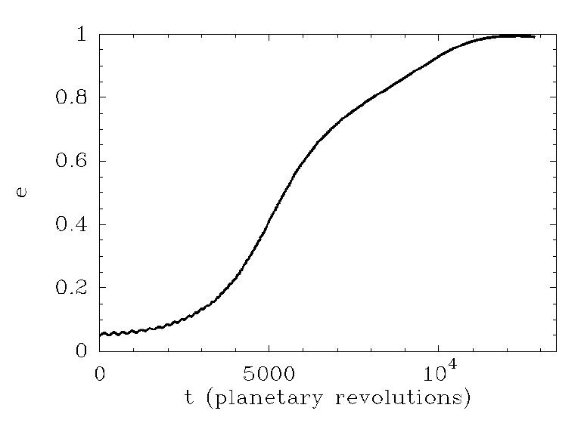
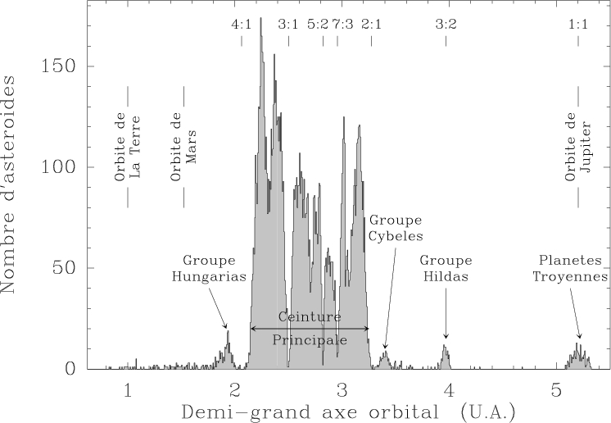
The mean-motion resonance model
(Beust & Morbidelli 1996, 2000, Thébault et al 2001, 2003)
Bodies trapped in some mean-motion resonances with a Jovian planet (4:1,3:1) see their eccentricity grow up to ~1  FEBs!
One requirement : The planet needs to have a moderate (>0.05) eccentricity.
The orientation of the FEBs orbits is constrained  explains the blue/red-shift statitics.
A similar phenomenon gave birth to the Kirkwood gaps in the Solar asteroid belt.
We expect variations in the arrival rate of FEBs depending on the longitude of the planet

Slide 12
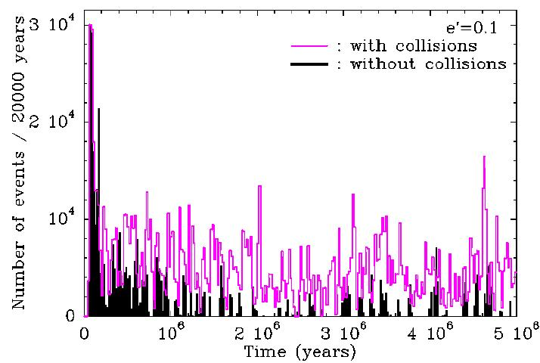
Duration of the phenomenon
The resonances clear out quickly (< 1 Myr) a Need for refilling to sustain the process
Collisions between
planetesimals are a
good candidate to
refill the resonances
(Thébault & Beust 2001)
But the disk gets
eroded  loss of
material (Thébault,
Augereau & Beust
2003)
In any case, need
for a lot of material
(~ 8 M⊕ per AU …)

Slide 13
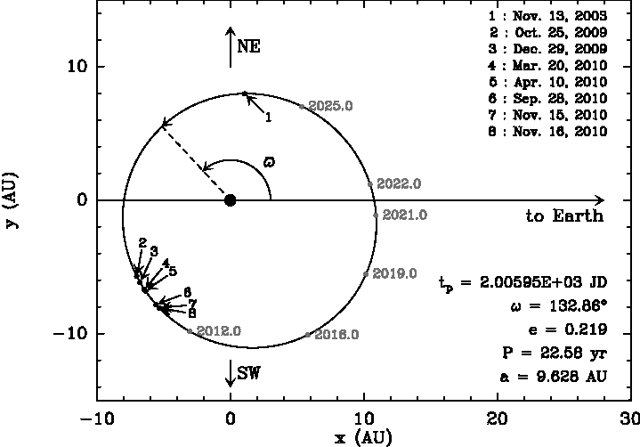
FEBs and β Pictoris b …?
Could the giant planet imaged in the disk (Lagrange et al. 2009) could be responsible for the FEB phenomenon ?
Is has the
good size
and it is at
the right
place…
We need to
better
constrain the
orbit ⇒
MCMC fit
of the
astrometric
data
(Beust et al.,
in prep.)

Slide 14
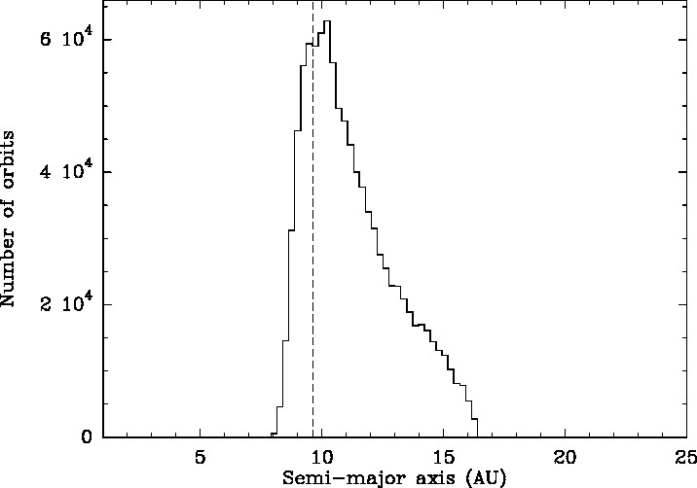
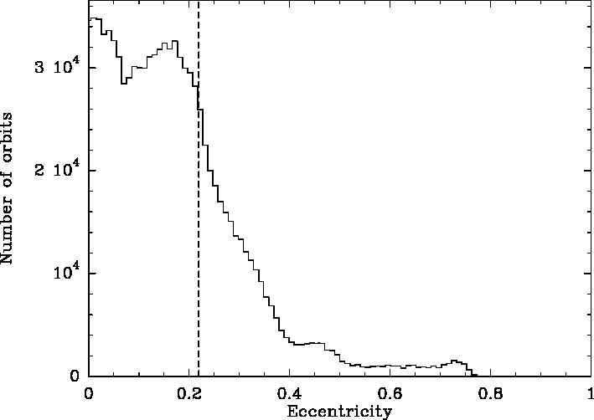
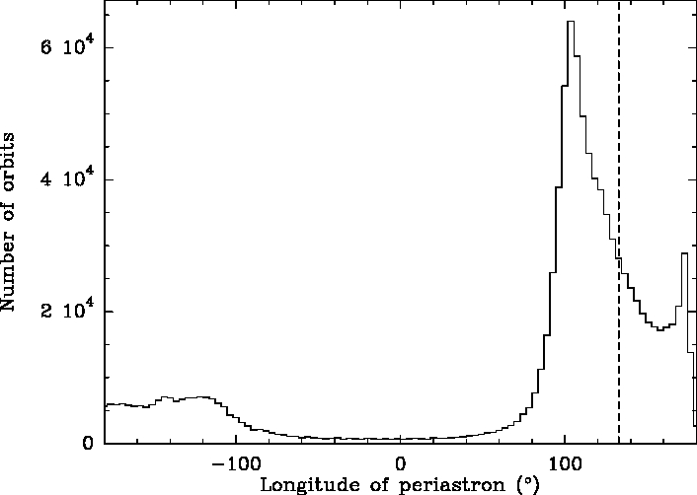
FEBs and β Pictoris b …?
Only the semi-major axis is well constrained;
But the orbit is probably eccentric, and we have ϖ>90° or ϖ <−90°
The FEB statistics suggests ϖ≈−70°. So, what ?
True with e≈0.05-0.1, but not with e≈0.2; (other sources of FEBs like 5:2)

Slide 15
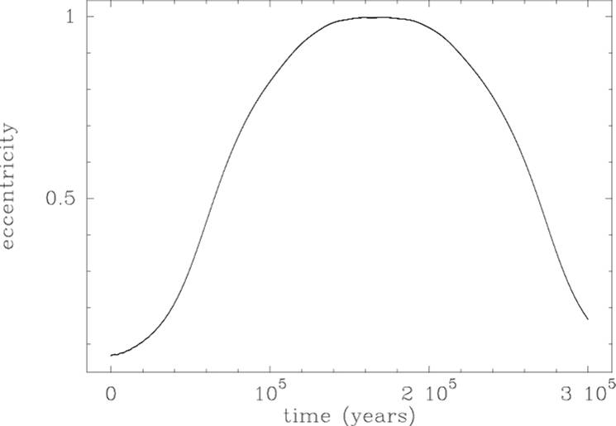
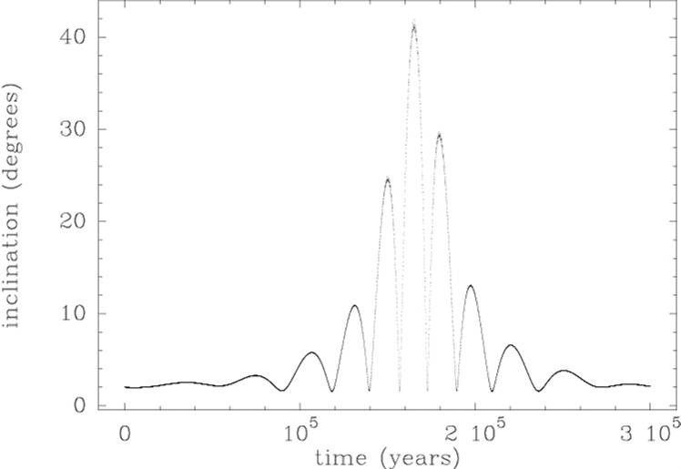
FEBs and out of midplane motion (I)
(Beust & Valiron 2007)
When a FEB arrives in high eccentricity regime (in its resonant motion), it undergoes inclinaison oscillations.
Even if the initial inclinaison is small (<2°), it can grow up to ~40° in the FEB regime.
This can be explained theoretically : ~ kind of Kozai resonance inside the mean-motion resonance dynamics

Slide 16
FEBs and out of midplane motion (II)
The ions released by the FEBs are blown away by the radiation pressure, but they keep track of their original orbital plane.
If the FEB has a large inclination, the ions get out of the midplane !
This process concerns Ca II which undergoes a strong radiation pressure but not Na I (due to photoionization).
This can explain the observation of off-plane Ca II and Na I (Brandeker et al. 2004)

Slide 17
II – Vega

Slide 18
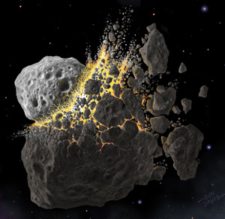
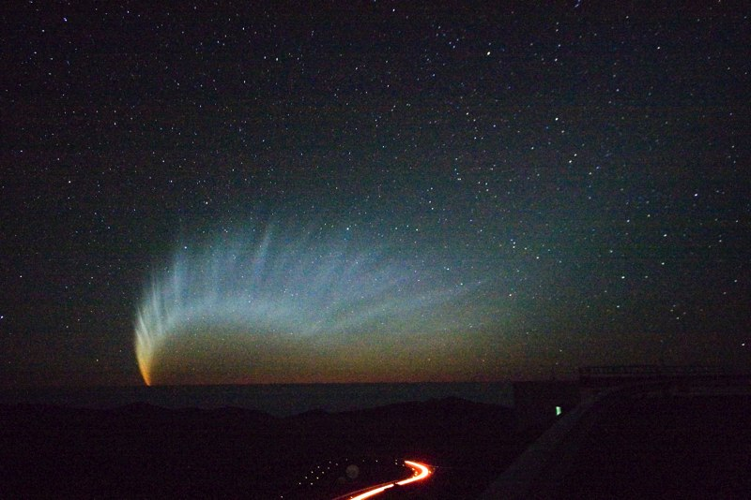
Vega’s exozodi : origin of the dust?
Dust particles are present in the inner disk of Vega (≲ 1 AU)
Exozodiacal dust grains have very short lifetime there
(sublimation, radiation pressure…)
➔ high dust production rate,
~10⁻⁸M_{earth}/year for Vega
  Equivalent to 1 medium-sized asteroid
  per year
  Equivalent to a dozen of Hale-Bopp-like
  comets passing every day
If we exclude the case of a dramatic
event, the question is:
Where does all this dust come from?

Slide 19
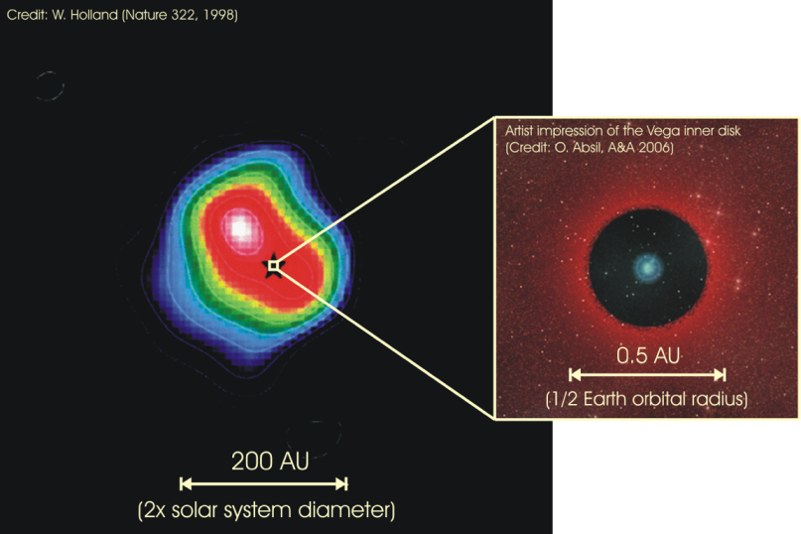
Vega’s exozodi : origin of the dust?
Inward migration of grains due to Poynting-Robertson drag is excluded : too slow compared to other dynamical timescales: collisions, radiation pressure
Steady-state erosion of an asteroid belt excluded: km-sized bodies in a 10⁻³ M_{Earth} belt at around 0.2-0.5AU do survive ~10⁵ years (Vega is about 350 Myr)
Existing reservoir of mass in
Vega’s Kuiper Belt ?
(~85AU, ~ 10M_{Earth}).
Yes, but how do you extract and
transport solid material inside 1 AU ?
Not in dust form (radiation pressure),
but in larger bodies ⇒ FEBs ?
Not exactly, but…
Planets can still help !
Schematic representation of the Vega system

Slide 20
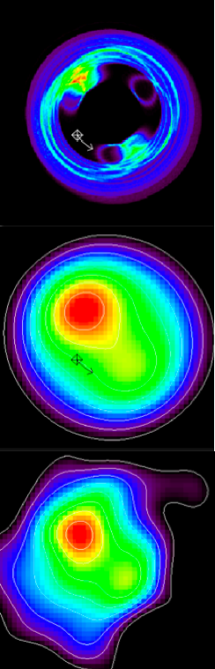
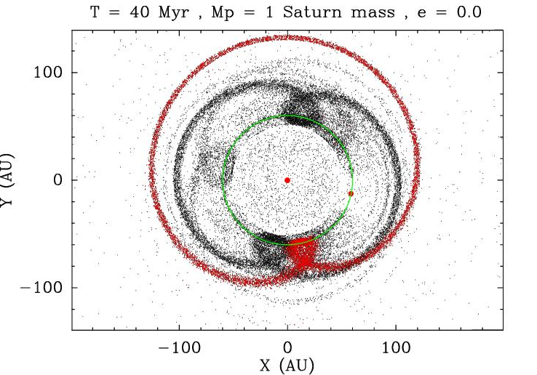
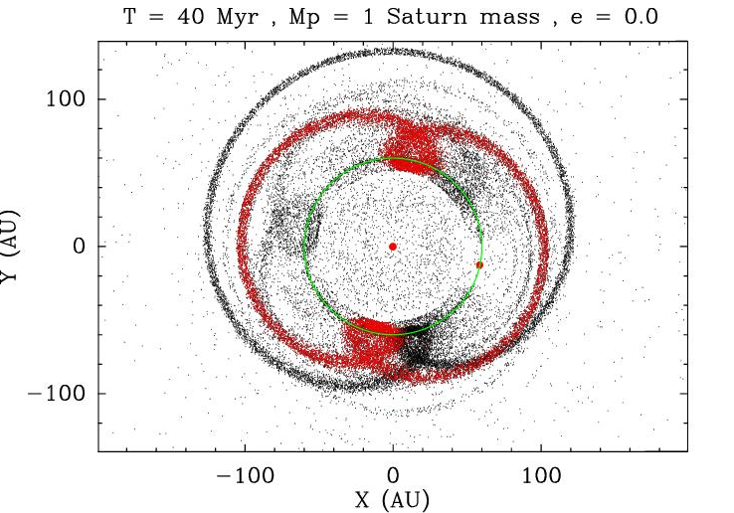
Vega: planet migration
Observed structures in the Vega Kuiper belt ⇔ migrating planet trapping the parent bodies of the dust grains in mean motion resonances
  Wyatt (2003): Neptune-mass planet, migrating from 40 AU to 65AU, at a rate of 0.5AU/Myr. Circular orbits.
  Reche et al. (2008): Saturn mass planet, with e<0.05,
  and relatively cold disk (⟨e⟩ < 0.1)

Slide 21
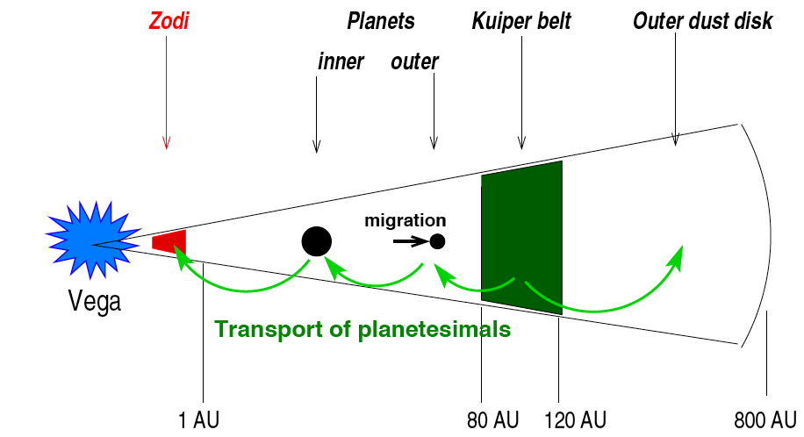
Vega: the comet factory
A several planets system:
  Migrating “Saturn” mass planet (Wyatt 2003, Reche et al. (2008))
  0.5 – 2 Jupiter mass planet inside (at least) to trigger the migration
Numerical simulations with SWIFT (Vandeportal et al. 2011) :
Monitoring the number of test particles entering the 1AU zone…

Slide 22
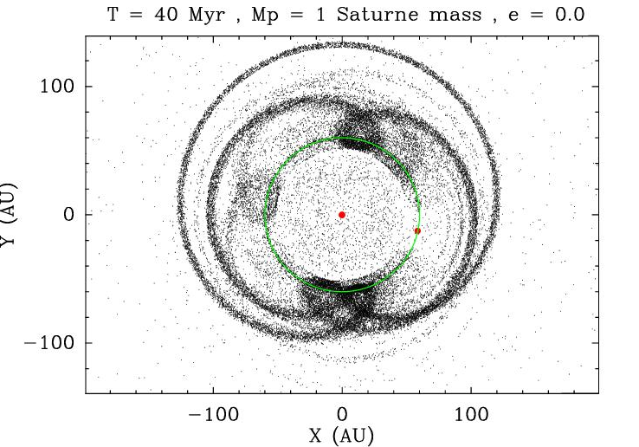
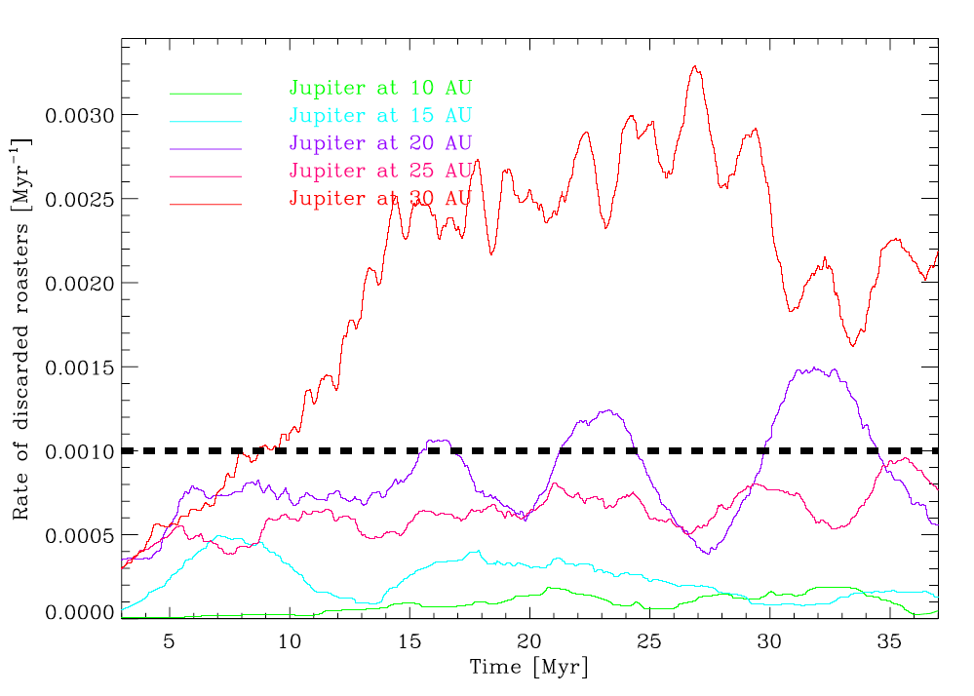
Vega: the comet factory
A two planets system (or more..) : our best model (Vandeportal et al. 2011)
  A migrating Saturn mass planet [Wyatt 2003, Reche et al. (2008)]
  A 0.5 Jupiter mass planet at ~20–25 AU does the job:
  &
Sufficient rate of comets
in the 1AU zone
Resonant structures
at 85AU preserved

Slide 23
Conclusions : β Pic and Vega : Same FEBs ?
NO !
  The asymmetry of the infall towards β Pic implies the mean-motion resonance model. No such constraint in Vega
  The β Pic FEBs originate from a few AU ≠ Vega
  The β Pic phenomenon is short lived (resonance clearing). At the age of Vega, it is probably ended.
  In Vega, the same FEBs would not be detected (pole-on)
BUT :
  Both phenomena deliver solids into the dust sublimation zone
  Planets are a common engine, and in both cases, mean-motion resonances are implied (indirectly in Vega)
  Material coming from outside could help refilling the β Pic resonances ⇒ link between the two models (the β Pic FEBs are icy (Karmann et al. 2001) )

