Slide 1
IOTA/IONIC observations of Vega results and lessons learned
Denis Defrère
10-02-2011
ANR kick-off meeting, IPAG
Notes:
IOTA/IONIC similar to PIONIER + same camera

Slide 2
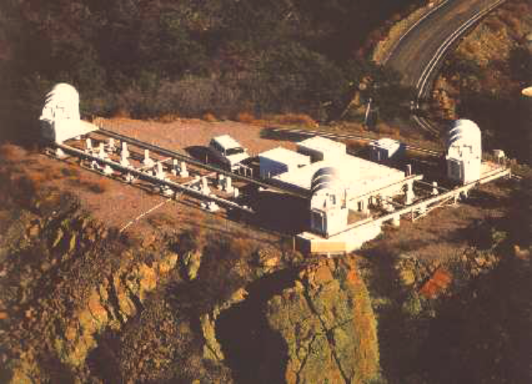
Context
Vega observed in June 2006 with IOTA/IONIC:
  4 nights of data (2 different triplets);
  H band (1.65 µm);
  Dual polarizations;
  PICNIC camera.
Data reduction effort:
  2006 - 2007: First data reduction;
  Sep. 2007: Non-linear regime and color problem;
  Nov. 2007: Polarization 2 is healthy;
  Nov. 2010: Color-dependant behaviour of the IONIC3 component;
  Present: reliable error bars.

Slide 3

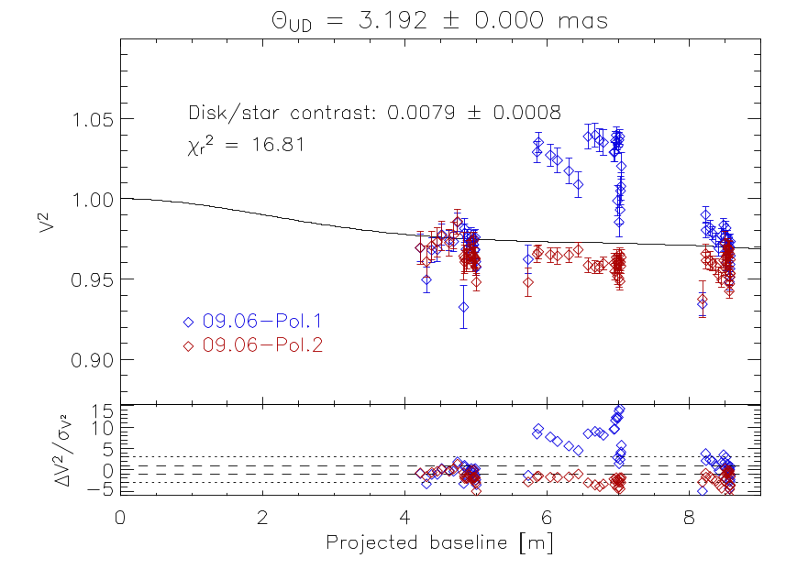
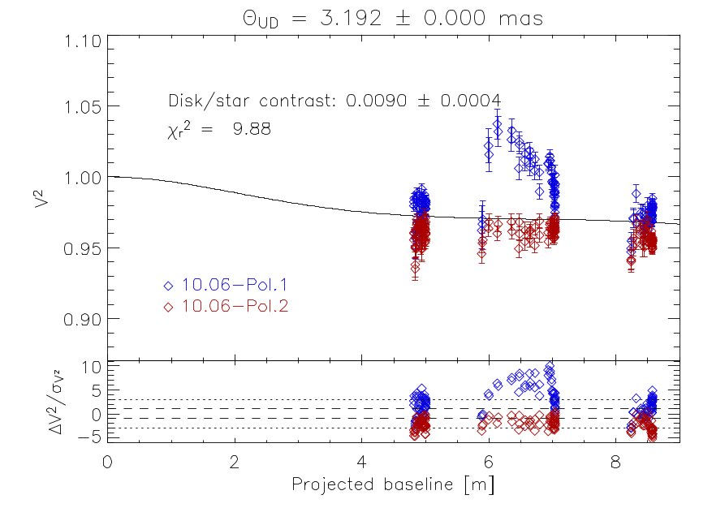
2006-2007
first reduction
Vega 09 June
Vega10 June

Slide 4
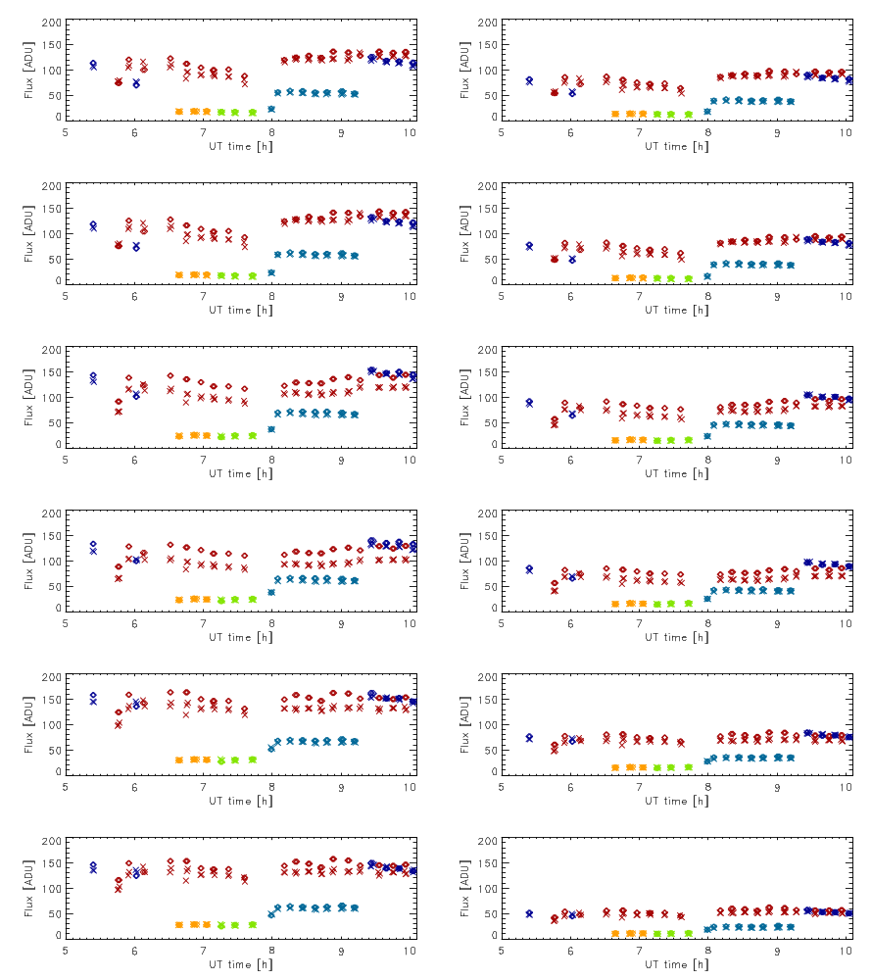
Sept. 2007: problems start!
Photometries
vs
time
x : interferometric
◊ : matrix
x : Vega (H=0.0)
x : π Her (H=-0.1)
x : θ Her (H=1.2)
x : λ Lyr (H=1.8)
x : κ Lyr (H=1.9

Slide 5
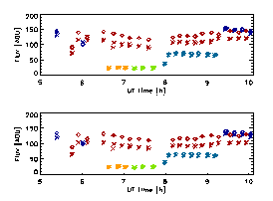
Sept. 2007: problems start!
Photometries
vs
time
x : interferometric
◊ : matrix
x : Vega (H=0.0)
x : π Her (H=-0.1)
x : θ Her (H=1.2)
x : λ Lyr (H=1.8)
x : κ Lyr (H=1.9)

Slide 6
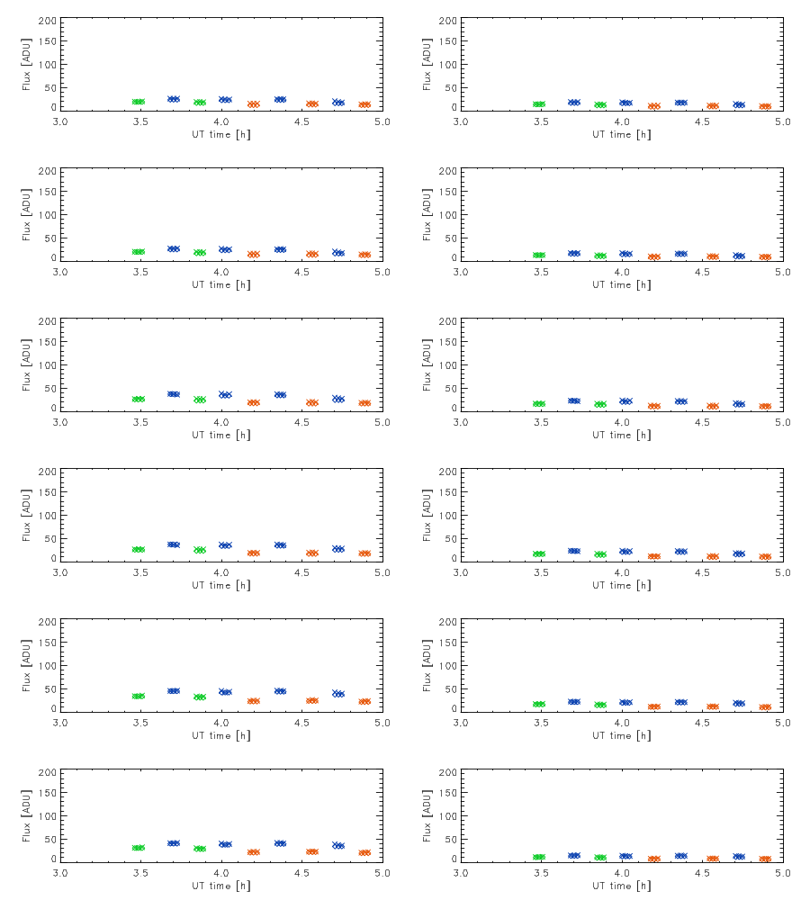
Sept. 2007: problems start!
Photometries
vs
time
x : interferometric
◊ : matrix
x : β Leo (H=1.9)
x : δ Leo (H=2.19)
x : 24 Com (H=2.5)

Slide 7
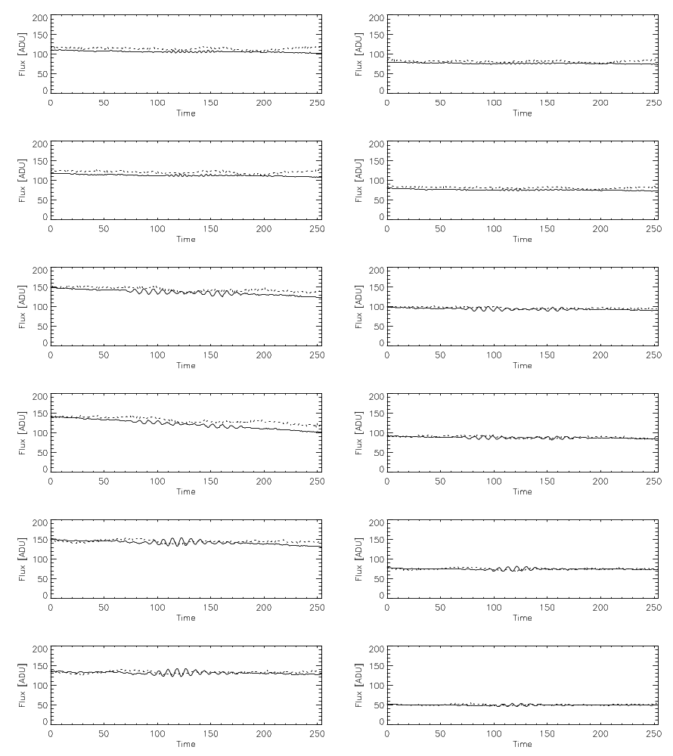
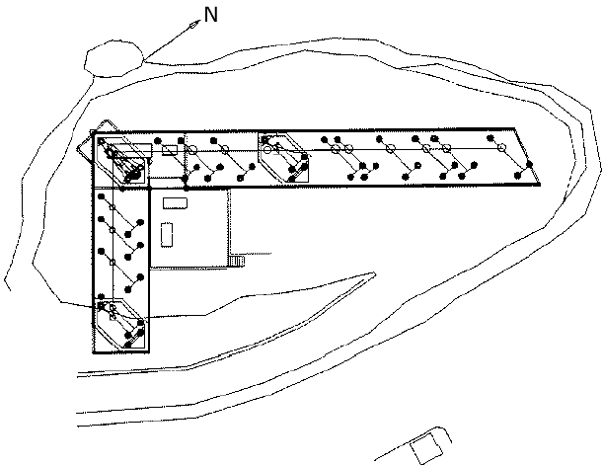
Typical scan for π Her
--- : matrix
: interferometric
B-C
C
A
A-C
B
A-B

Slide 8
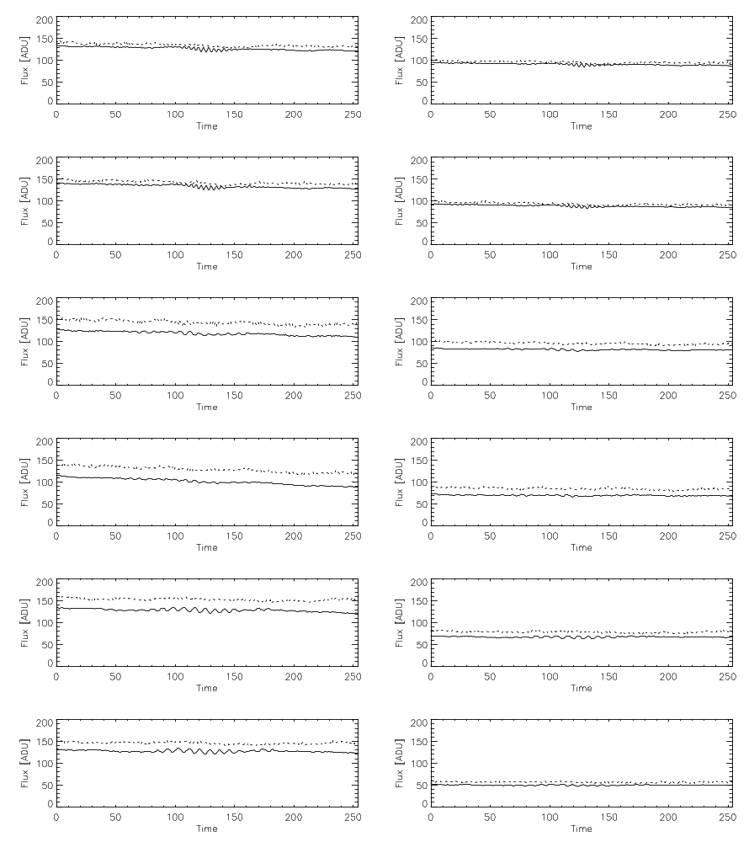
Typical scan for Vega
--- : matrix
: interferometric
B-C
C
A
A-C
B
A-B
Notes:
Offset event at the beginning of the scan!!!!!!
Problem at the reset? Negative value?
We have observed that when a single pixel in the row containing the interferometric signals is strongly illuminated (but not saturated), the dark level on neighboring pixels are corrupted: the photometric signal becomes negative, clearly an effect due to an analog transient and not a true light or charge leakage effect.

Slide 9
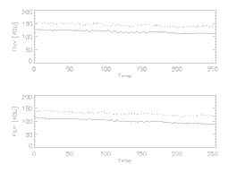
Typical scan for Vega
B-C
2 problems!
Slope during the scan.
Offset between the matrix and interferometric files.
A-C
A-B
Notes:
Offset event at the beginning of the scan!!!!!!
Problem at the reset? Negative value?
We have observed that when a single pixel in the row containing the interferometric signals is strongly illuminated (but not saturated), the dark level on neighboring pixels are corrupted: the photometric signal becomes negative, clearly an effect due to an analog transient and not a true light or charge leakage effect.

Slide 10
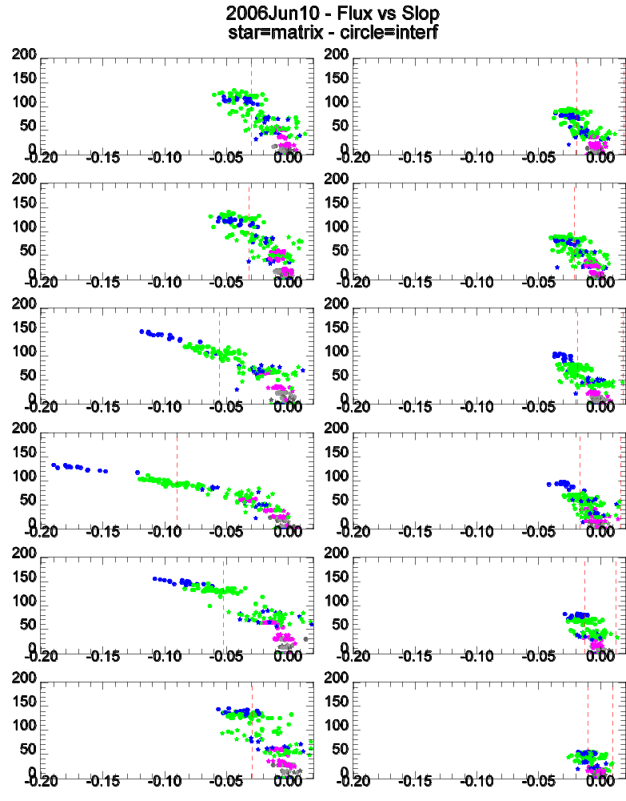
Slope problem: non-linear regime
x : Vega (H=0.0)
x : π Her (H=-0.1)
x : θ Her (H=1.2)
x : λ Lyr (H=1.8)
x : κ Lyr (H=1.9)

Slide 11
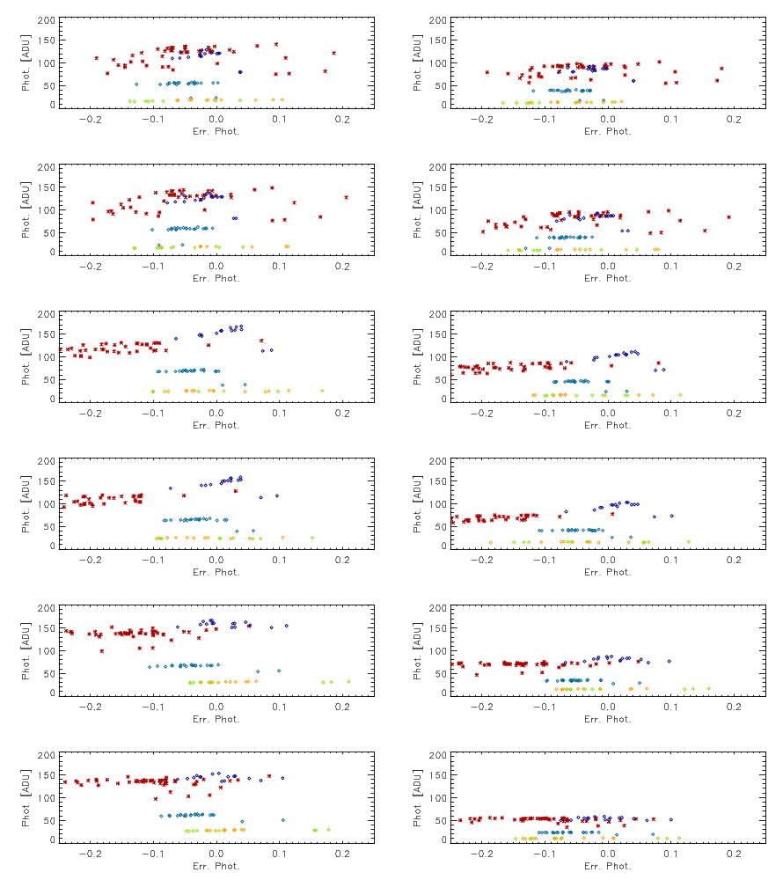
Offset problem: color related
x : Vega (H=0.0)
x : π Her (H=-0.1)
x : θ Her (H=1.2)
x : λ Lyr (H=1.8)
x : κ Lyr (H=1.9)

Slide 12
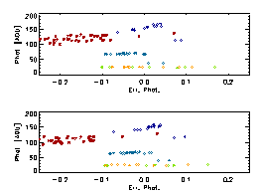
Offset problem: color related
x : Vega (H=0.0)
x : π Her (H=-0.1)
x : θ Her (H=1.2)
x : λ Lyr (H=1.8)
x : κ Lyr (H=1.9)
Notes:
Origin unknown

Slide 13
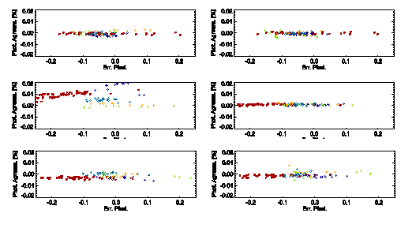
Offset problem: origin?
Not related to non-linearity
Kappa coefficients OK
Notes:
Origin unknown

Slide 14
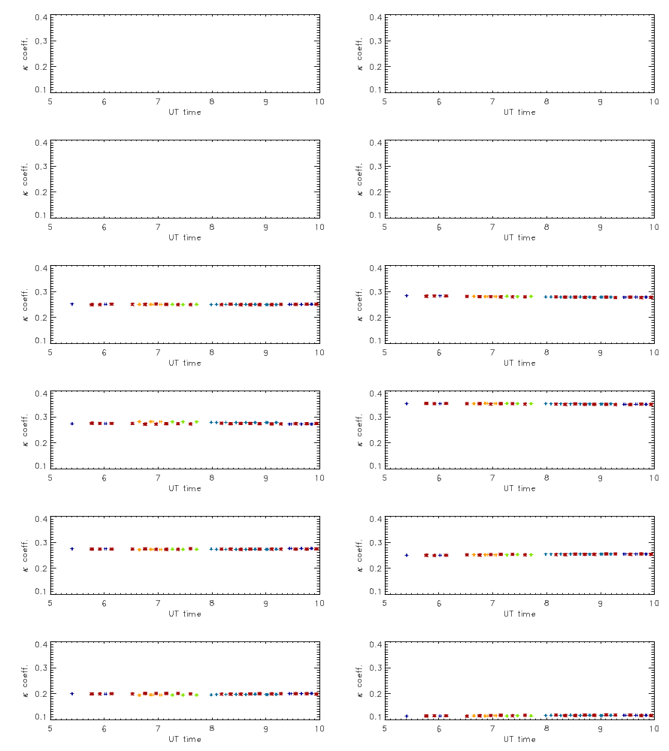
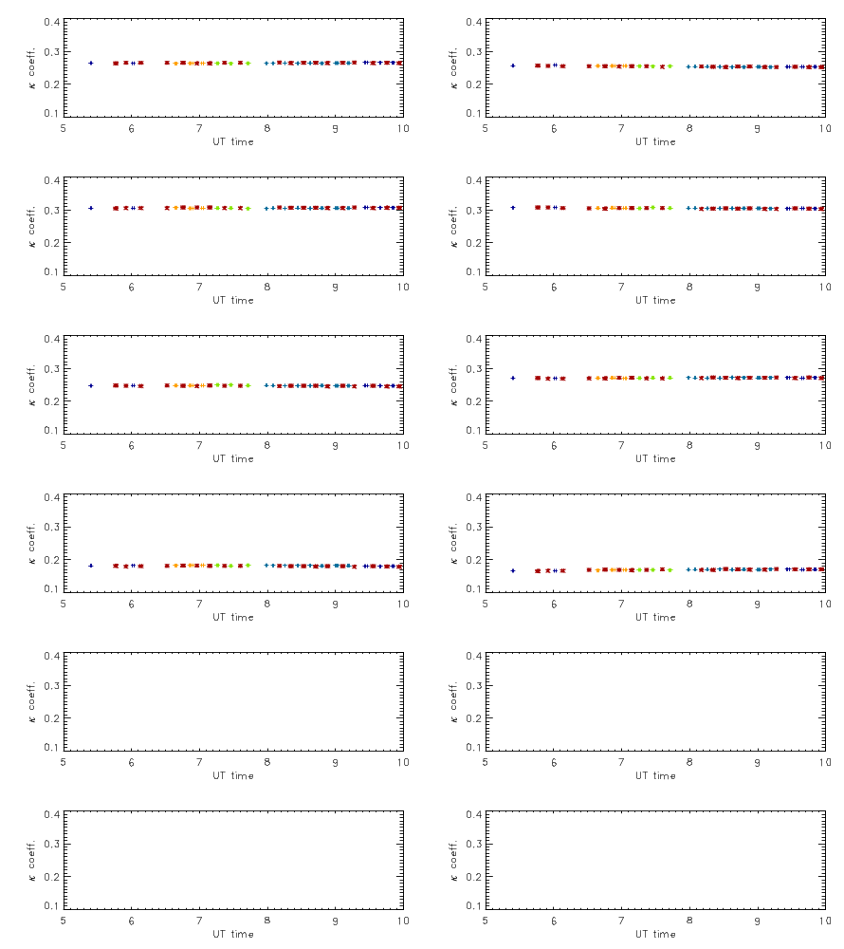
Kappa coefficients
x : Vega (H=0.0)
x : π Her (H=0.1)
x : θ Her (H=1.2)
x : λ Lyr (H=1.8)
x : κ Lyr (H=1.9)

Slide 15
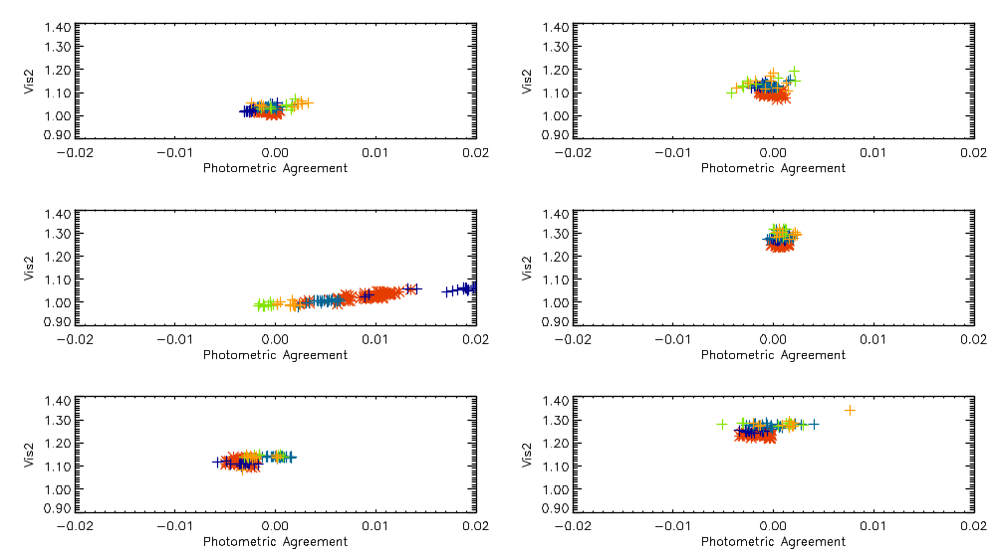
Impact on raw V2
Non-linearity spoils V2

Slide 16
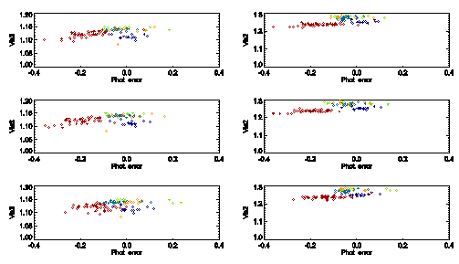
Impact on raw V2
Offset no significant impact

Slide 17
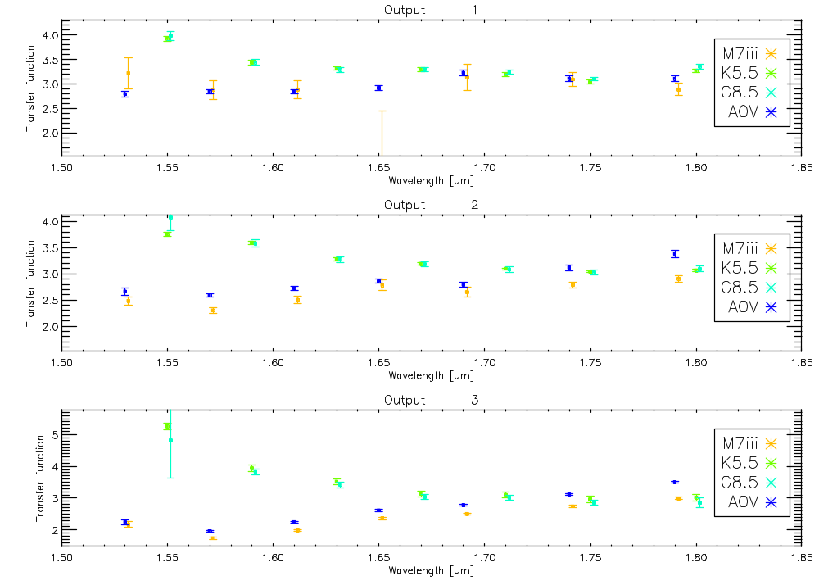
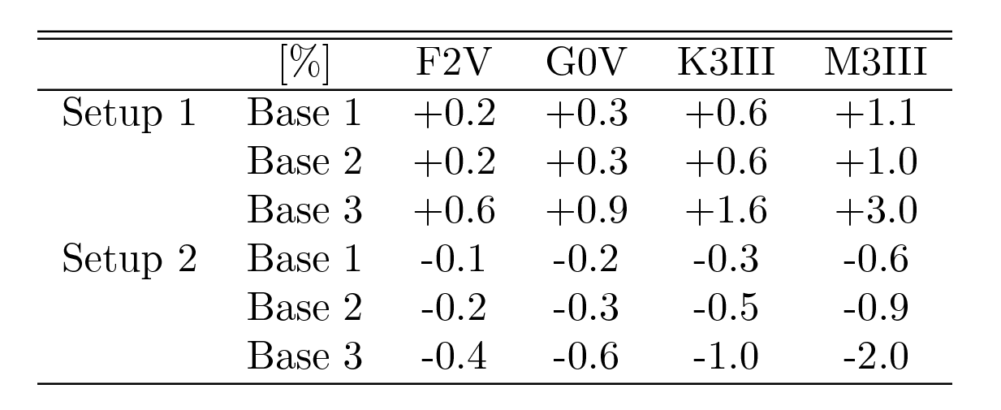
Chromatic response of IONIC
Analysis of dispersed data
  Setup 1: Lacour 2006
  Setup 2: Pedretti 2006

Slide 18
What have we learned?
Camera-related problems:
  Non-linearity: impact on V2
  Offset matrix-interferometric fluxes: no impact on V2
IONIC3-related problem:
  Chromaticity of the component: main limitation on broadband V2
  Chromaticity is setup-dependant!

Slide 19
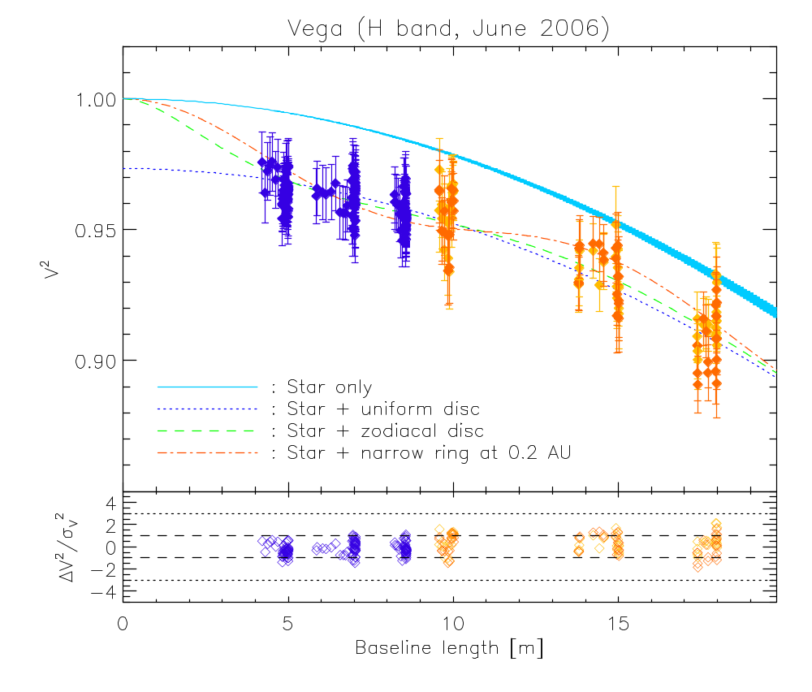
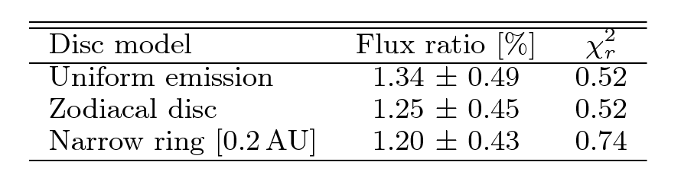
Data analysis
Detection of an H-band excess at the 3-σ level

Slide 20
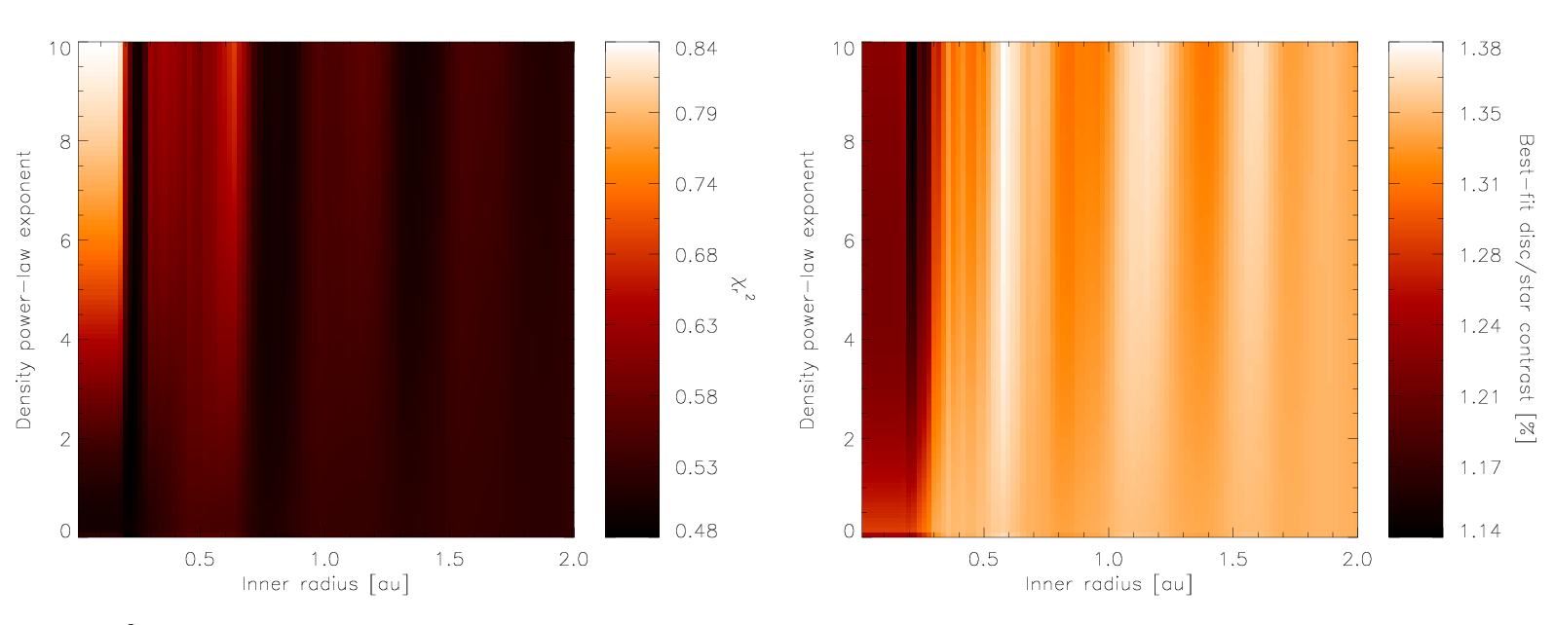
Data analysis
Geometry not constrained

Slide 21
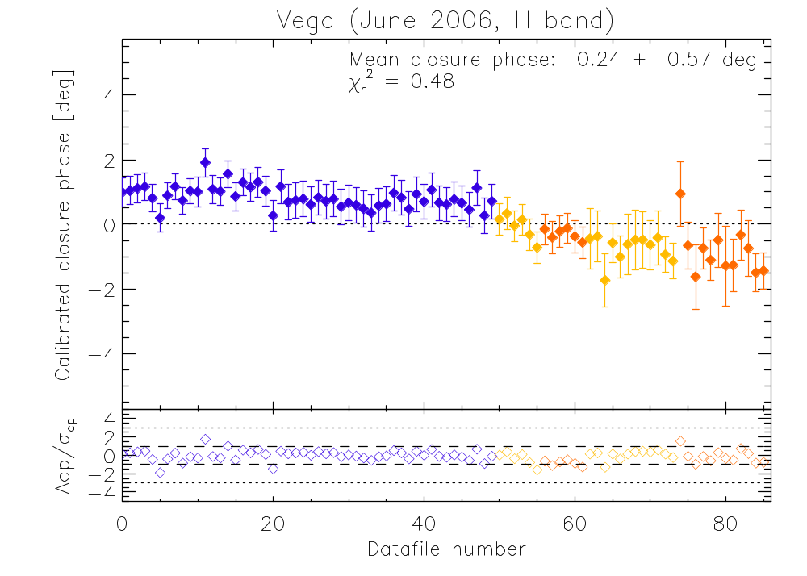
Data analysis
Point-symmetric brightness distribution

Slide 22
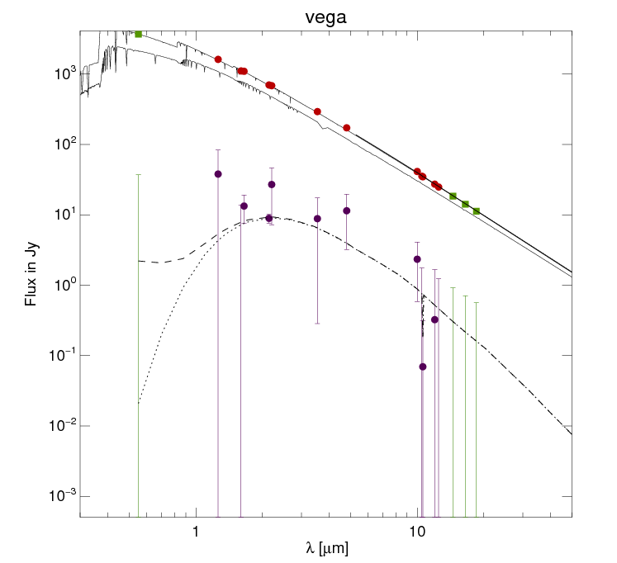
EZ dust disk modeling
Best fit SED:
Density profile
-3
50% Silicates
&
50% Carbon
Ro ~ 0.05 au

Slide 23
Summary
3-σ confirmation of exozodiacal dust around Vega
  Best fit for a narrow annulus (Ro ~ 0.05 au)
  Point-symmetric brightness distribution
  Consistent with fiber nuller and Keck nuller “non-detection”
Long data reduction effort to prove high-accuracy V2
  IONIC3 chromaticity is the main limitation (otherwise <0.5% accuracy)
  Characterize it for PIONIER! (and used good calibrators)

