Slide 1
Modeling debris disks with GRaTeR
(Grenoble Radiative TransfeR)
Jérémy Lebreton
EXOZODI Kick-off Meeting
10-02-2011

Slide 2
Introduction
Different and complementary approaches to model debris disks
  Collisional
  Dynamical
  Radiative transfer
GRaTeR:
  Originally designed to model cold dust disks around Kuiper-Belt analogues like HR4796A (Augereau et al. 1999)
  Efficient radiative transfer modeling of optically thin disks
  Fitting SEDs, resolved images and interferometric observations
  Allows statistical analysis on a large parameter space.

Slide 3
General description of a debris disk
Star properties
  Spectral type, magnitude, distance
Geometrical properties
  Surface density profile
  Inclination
Dust grains properties
  Size distribution
  Composition

Slide 4
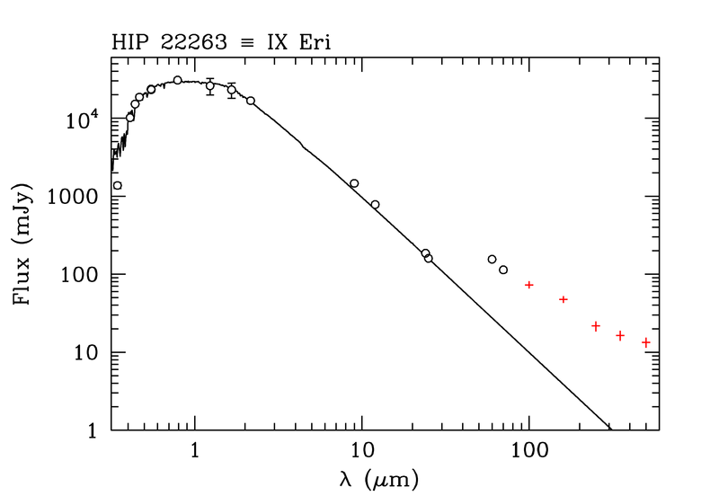
Stellar photosphere
NextGen synthetic stellar spectrum (log g, T_{eff})
  Scaled to V magnitude or Spitzer IRS spectrum
Excess emission
NextGen stellar Spectrum

Slide 5
Surface density profiles
Parametrical profiles
  1-power law (r₀, α_{out})
  2-power law (r₀, α_{in}, α_{out}): Ring-like disks
  Anything you want
Profiles derived from inversion of resolved images
Profiles derived from dynamical models

Slide 6
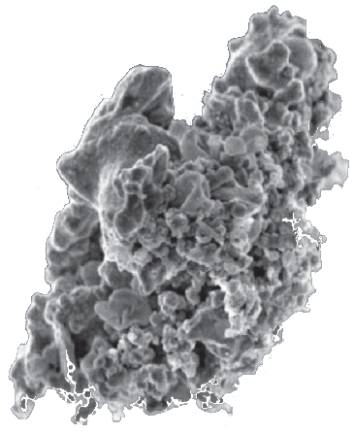
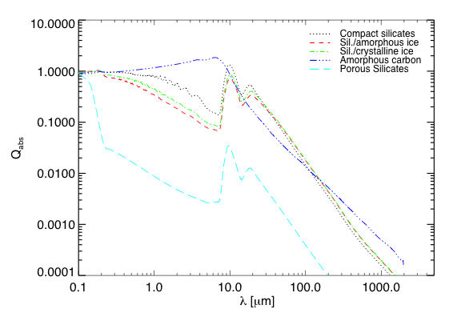
Grain composition
Optical indexes available for various materials
  Amorphous silicates, olivine, ...
  Carbon, organic refractories, ...
  Amorphous, crystalline ices, ...
Multi-component grains
  Use of an effective medium theory
  (Maxwell-Garnett / Bruggeman EMT)
Porous aggregates
  The spheres are partly filled with vacuum

Slide 7
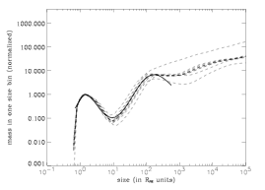
Grain size distribution
Classical power-law
  dn/da ∝a^{-κ,} from a_{min} to a_{max}
  idealized collisional equilibrium: κ = -3.5
  Independent of the distance from the star
« Wavy » size distribution
  (Thébault & Augereau 2007)
Possibly a distance-
dependent distribution
...

Slide 8
Grain response to stellar irradiation
Mie theory - Valid for hard, spherical grains
    Absorption efficiency : Q_{abs}(a, λ, composition)
    Scattering efficiency : Q_{sca}(a, λ, composition)
    Radiation pressure efficiency Q_{RP}(a, λ, composition)
  Possibly anisotropic scattering : g_{HG}
  ( Q_{PR} = Q_{abs} + (1-g_{HG})Q_{sca} )

Slide 9
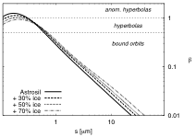
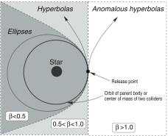
Physical process
Beta ratios (F8 star)
Central star’s gravity
Drag forces
  Radiation pressure
    β_{PR} = |F_{RP} / F_{G}|
    Blowout size : a_{blow} = a(β_{PR} =0.5)
    Eccentricity: e(β_{PR}) = β_{PR}/(1-β_{PR})
  Poynting-Robertson drag
Krivov et al. 2006

Slide 10
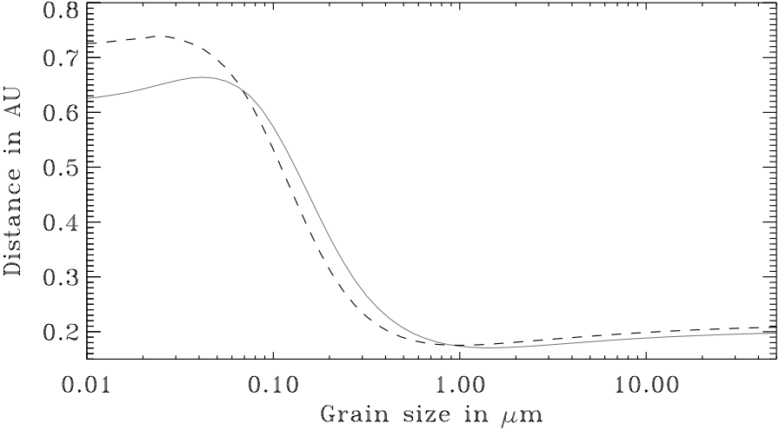
Physical process
Sublimation
  Each material → sublimation temperature
  Each grain → equilibrium temperature vs. distance
    ⇒ sublimation distance D_{sub}
  When D < D_{sub} : material is removed
  A more sophisticated
  treatment of the grain
  sublimation physics
  (cf. next previous talk)
- Solid line : 50% silicates + 50% carbons
- Dashed line: 100% carbons

Slide 11

Physical process
Collisions
  Collision time scale
      To date: ~ t_{orb}/8Σ₀(r)
      (Backman & Paresce 93)
      Π<s²> : mean scattering cross section
      Σ₀(r) : Midplane surface density
      Independent of the grain size
      Valid for circular orbits

Slide 12
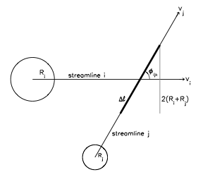
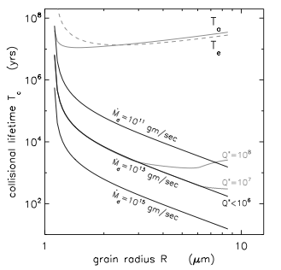
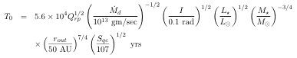
Collision time scale
Need for a more sophisticated calculation of the collisional lifetime
  Method from Hahn et al. 2010
    Considers all possible orbits and grain sizes
    Calculate collision probability densities between
    streamlines
    Tc(s_{i}) α T0

Slide 13
Output of the model
Fitting strategy:
  Chi-square minimization
  Bayesian analysis
    Independent assessment of each parameter + uncertainties
Provides the best parameters:
  Disk mass
  Grain properties (size distribution, composition)
  Dust location
And additional ouput:
  Blowout size
  Optical depths
  Time scales

Slide 14
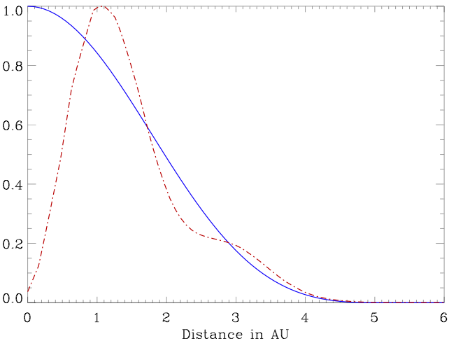
Notes on Exozodi models
Interferometric observations :
  Need to take the transfer function
  into account (spatial filtering)
Sublimation process are very important
  Transient events, …
Other specificities ?
Blue: near-IR CHARA
Red : mid-IR MMT nulling

Slide 15
Examples of GRaTeR achievements

Slide 16
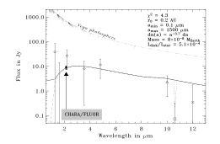
The Vega inner system
Detection of the exozodi with CHARA/FLUOR
Short baseline visibility deficit → K-band excess 1.29±0.19%
Absil et al. 2006
Submicronic grains
(a_{min} ≤ 0.3 μm)
Highly refractive: graphite/ amorphous carbon + Olivine (~50-50)
Concentrated close to the star:
  r0 = 0.17–0.30 AU
(@0.1μm: r0 < r_{sub} ~0.6AU)
M_{disk} = 8x10⁻⁸ M_{Earth}

Slide 17
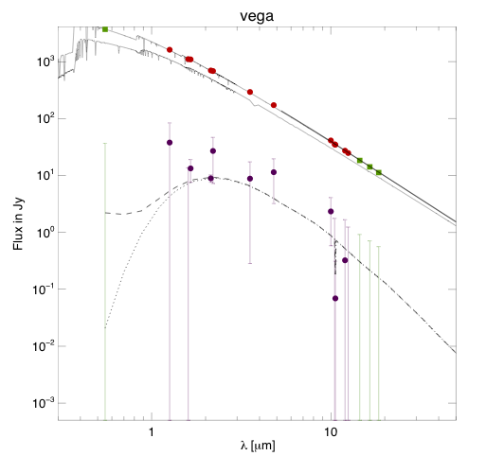
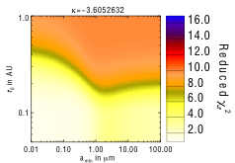
The Vega inner system
New IOTA/IONIC H-band measurements and models
Sublimation temperatures were re-evaluated:
T_{sub} (astrosi) = 1200 K
T_{sub} (Acar) = 2000 K
Spatial distribution could be
less steep (r ≤ -3.0)

Slide 18
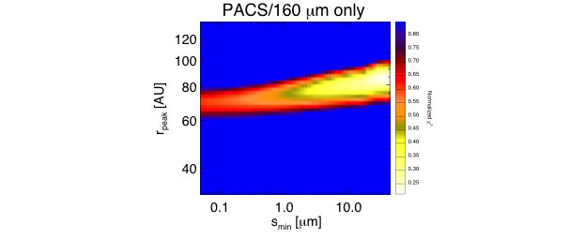
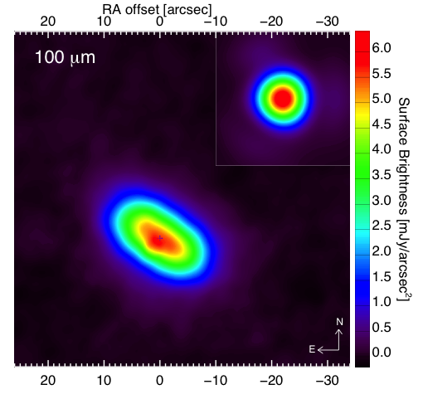
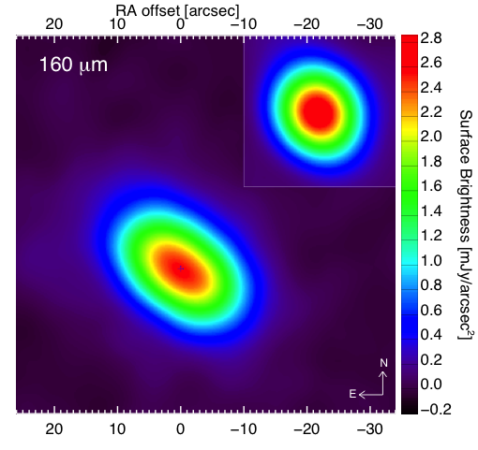
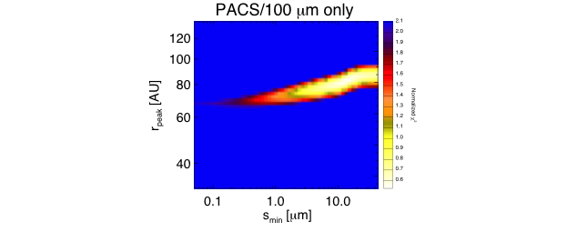
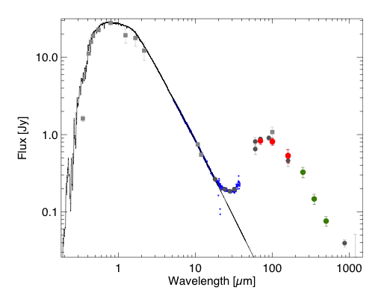
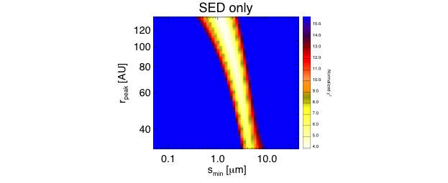
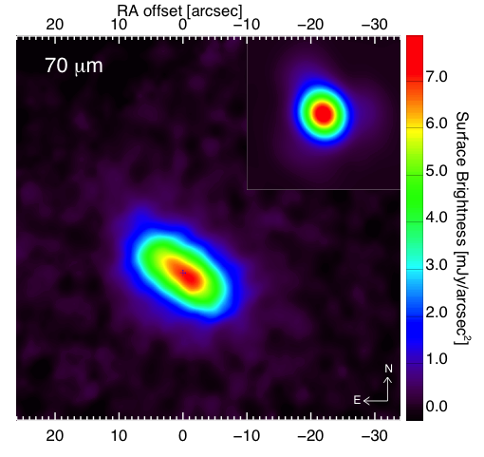
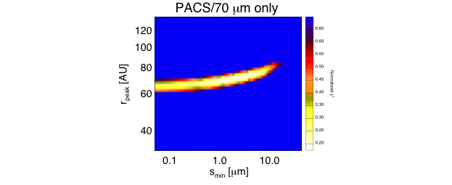
q1 Eridani
A planet host-star harboring a cold debris disk (2 Gyr, F8V star, 17 pc)
Augereau et al. 2011 (in prep.)

Slide 19
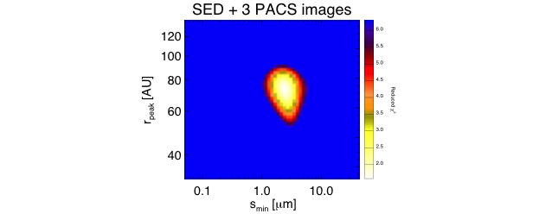
q1 Eridani
Detailed simultaneous modeling of the SED and PACS images

Slide 20
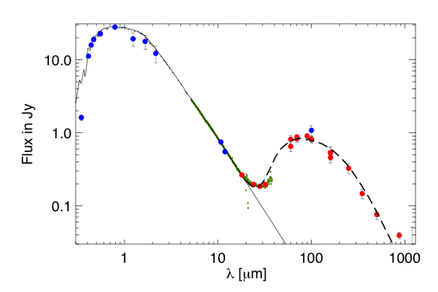
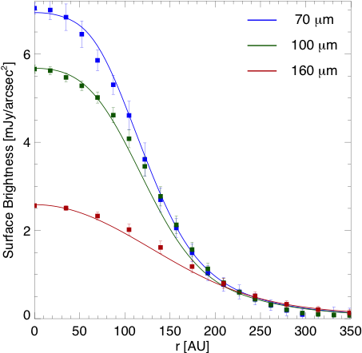
q1 Eridani
Detailed simultaneous modeling of the SED and PACS images
Dust Ring:
  Mass : 0.04 M_{Earth}
  Surface density: r ⁻²
  Belt peak position: 75-80AU
Grain properties:
  Minimum grain size ~ 1.5 μm
  Size distribution: - 3.5 power law index
  Close to 50-50 silicate-ice mixture
Fit to the SED
Fit to the PACS Radial Profiles

Slide 21
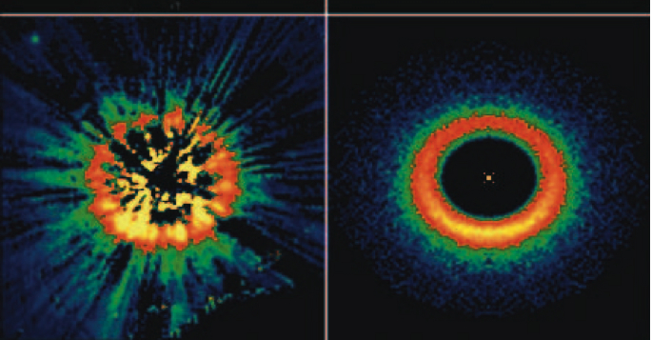
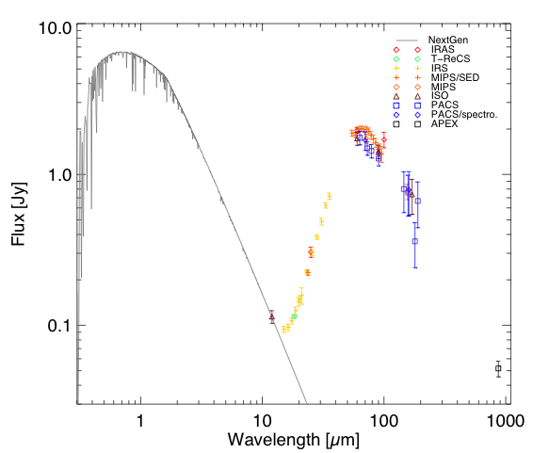
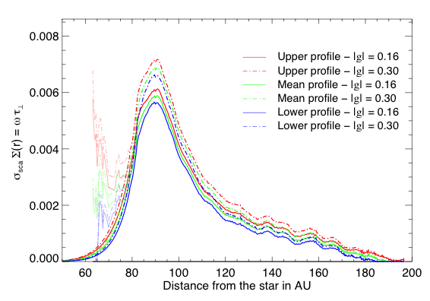
HD 181327
Lebreton et al. 2011 (in prep.)

Slide 22
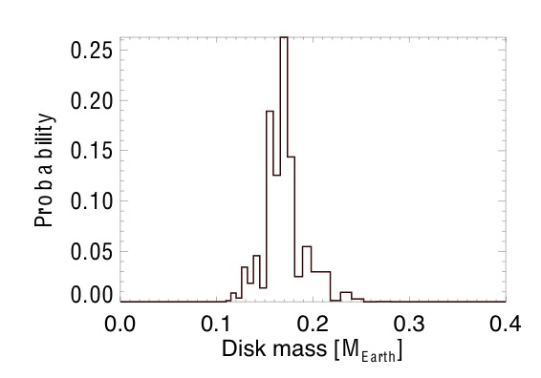
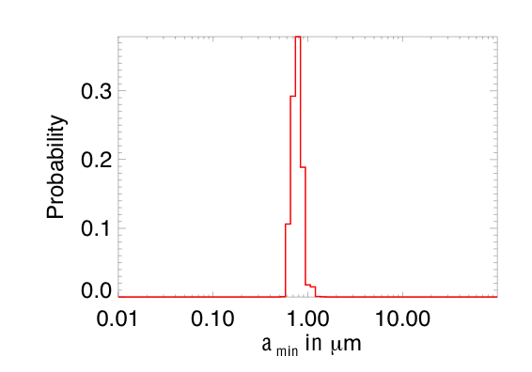
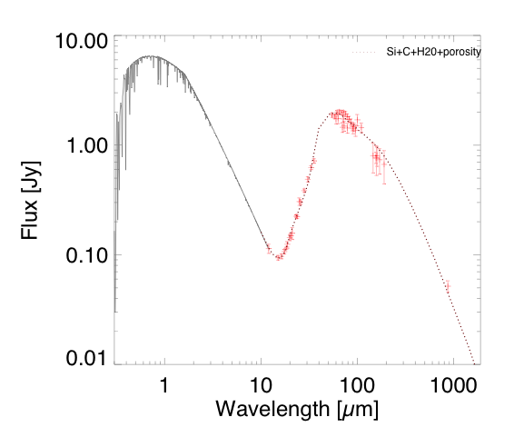
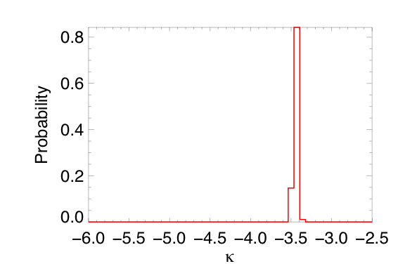
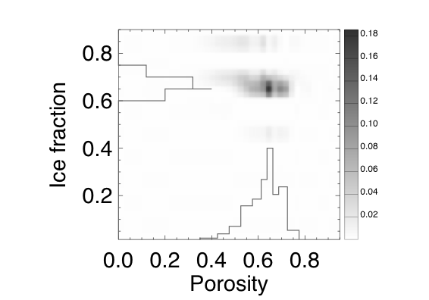
HD 181327
Best model
Composition
Astrosilicates: 20%
Organic refractory: 10%
Amorphous ice: 70%
Vacuum: porosity = 65%
Size distribution
dn ∝ a^{-κ}.da
  κ = - 3.43
  a_{min}=0.70 μm < a_{blowout}=5.46 μm
Mass = 0.05 M_{Earth}
(up to 1mm)
Temperature : 40-88 K
Up to 8 mm here!

Slide 23
Conclusions
GRaTeR is a flexible toolbox to model dusty disks
  Will be used to model systematically the SED of the near-IR excess detected through interferometry
  Will be coupled to the dynamical codes to derive synthetic observations
Future improvements
  Better description for the dust sublimation
  Better estimates of the time scales

